Slide 1

Time Series Analysis for Reliance Industries
Group 10
Bulli Rama Teja Pothula, Sindhuja Rajasekhar, Benjamin Hood, Lalitha Valeti, Charles Edwards

Slide 2
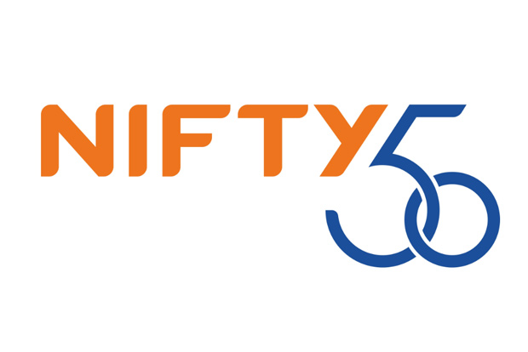
Data Description
Nifty 50 launched in April 1997
13 Sectors
Data set supplied by Kaggle
52 files for each company
Downloaded 14 thousand times
770 variables in total
Commodity stock chosen is Reliance Industries Limited
Notes:
Benjamin - India’s NIFTY 50 is a stock index of the 50 largest companies on India’s National Stock Exchange (NSE). Industries included in the index are banking and financial services, pharmaceuticals, energy, automotive, information technology, consumer goods, and commodities. In total there are 13 sectors incorporated in the Nifty 50 index. This data set comes from the NIFTY 50. It was supplied by Kaggle. The Nifty 50 was launched on the Indian stock exchange in April 1997. The index has shaped India's financial market as the single largest financial equity in India that has spawned a whole slew of ETFs and trading options notably the SGX Nifty in Singapore. India's NSE (National Stock Exchange) provided the source of the data which spans from January 1, 2000, till April 30, 2021. The top-performing stock ticker is TITAN and the worst performer is JSWSTEEL. New trends appear in the Nifty 50 every day with the fluctuation of the stock market and to have the most useful information the dataset is updated once a month. From Kaggle alone this data set has been downloaded 14 thousand times and has been used to develop trading algorithms.

Slide 3
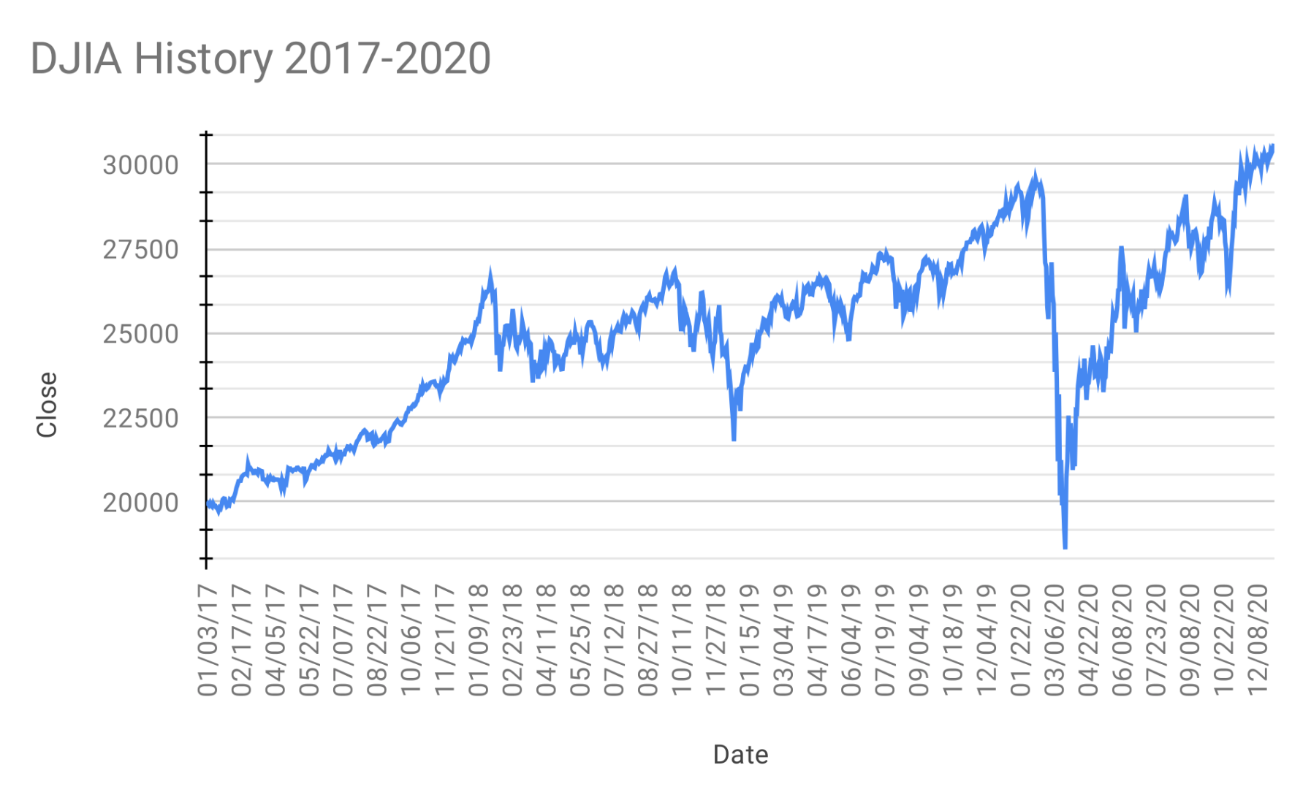
Problem Description
Covid -19 crashed the stock market in May 2020
This affected many industries despite stock predictions
Some stocks are more resilient than others
Many stocks are forecasted using weighted averages
Was a stock accurately forecasted throughout the pandemic?
If we make a time series prediction before the pandemic can we see if a stock was unaffected by the pandemic?
Notes:
Benjamin -
Due to the effect of pandemic, there was sudden drop in stock prices in the energy sector in India and later a gradual increase was observed.

Slide 4

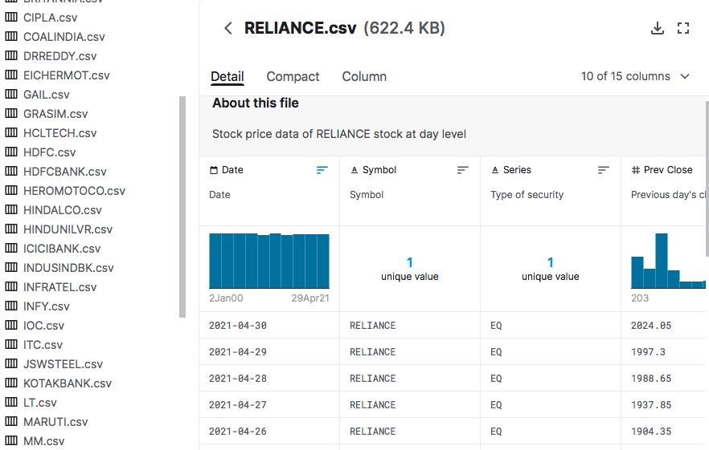
Project Solution
Using the time series analysis, we will be analyzing the effect of Covid-19 on the stock market in May 2020.
To understand this, we have opted the stocks of major contributor in the energy sector, Reliance Industries and build models to analyze the patterns of the stocks and forecast future predictions.

Slide 5
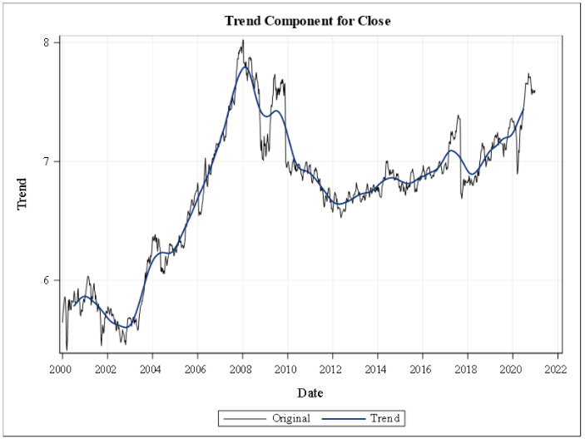
Trend-PreCovid
There is a visible trend in the plot.
Some of the spikes we can see are at 2008, 2010, 2017 & 2018
Notes:
2008 - recession
2010 - Acquisition of broadband services- Infotel, sucecssful bidder for pan india 4G spectrum aiction.
2017 - Jio venture
2018 - Comments of the Finance minister's proposal in the budget speech

Slide 6
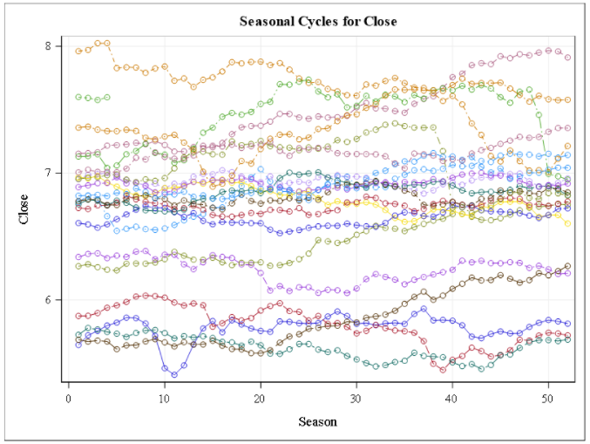
Seasonality
There appears to be no visible seasonality present in the seasonal cycle for Close.
However, there are a number of events that influence the direction of stock values in the market.
Notes:
Ram

Slide 7
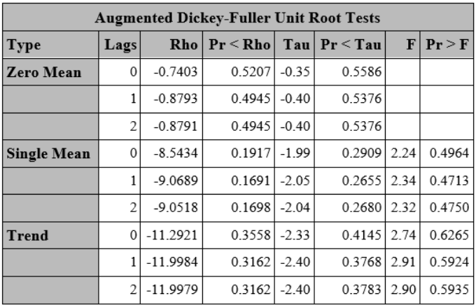
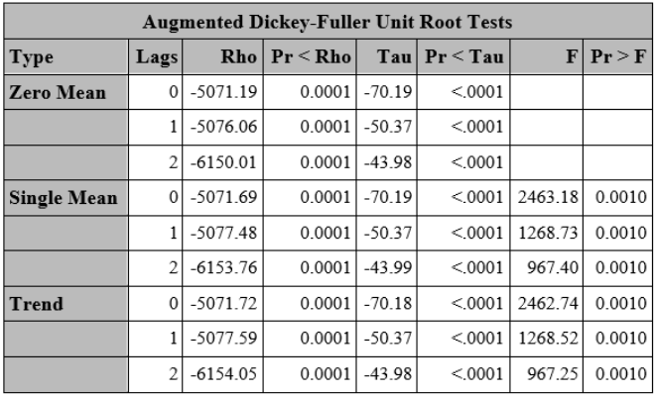
Dickey-Fuller Test
Non-stationary behavior of the time series is seen in the Trend.
Differencing order of one is applied to make time series stationary.
We ran the Dickey-Fuller Unit root test to confirm the series is stationary.
P-value < 0.05, which confirmed the time series is stationary after first order differencing.
Notes:
Ram

Slide 8
Pre-Whitening & Variable Selection
Our dependent variable is CLOSE price
Our independent variables before pre-whitening were Open, High, Low, Last, VWAP, Volume, Turnover, RAMP (external events)
After pre-whitening we considered VWAP, Last, Low, High, Open and Previously closed as final variables due to high correlation with dependant variable.
These variables are playing major role for forecasting the price of Close.

Slide 9
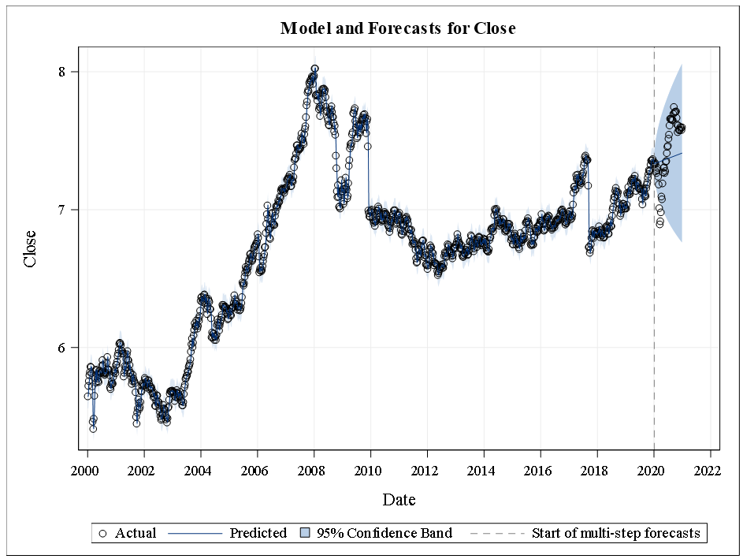
Exponential Smoothing:
As our data has no seasonality and has trend we used Brown, Holt, damp models.
Though the forecasted data is present within the 95% confidence interval, the Holt model didn’t perform well in the prediction.

Slide 10
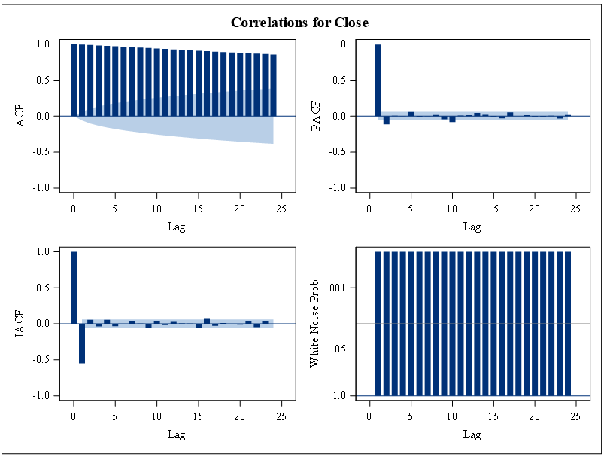
AR Model:
Gradual decrease in ACF Lag value.
There are two statistically significant spikes at lag 1,2 for the Close PACF.
No white noise

Slide 11
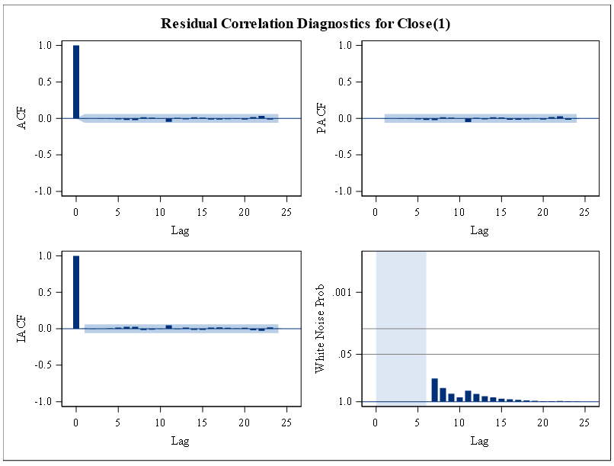
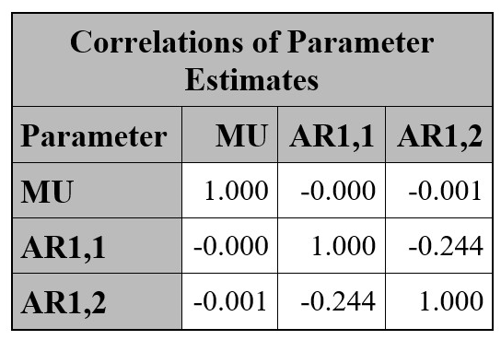
ARIMA Model
Considering p=4, d=1 and q=2 we obtained the following plot.
The correlation between the residuals for the first 24 lags is not significant.
The residuals appears to be white noise.

Slide 12
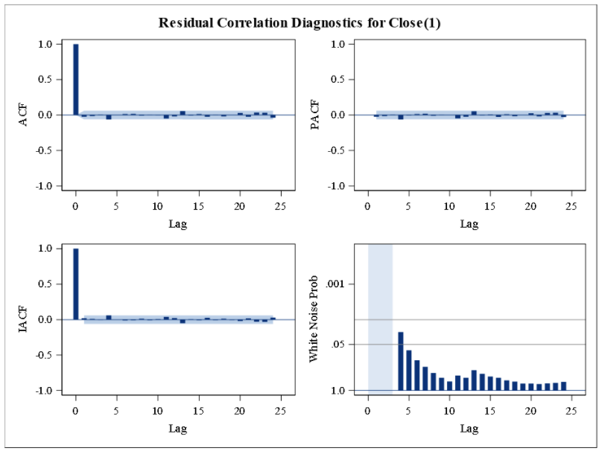
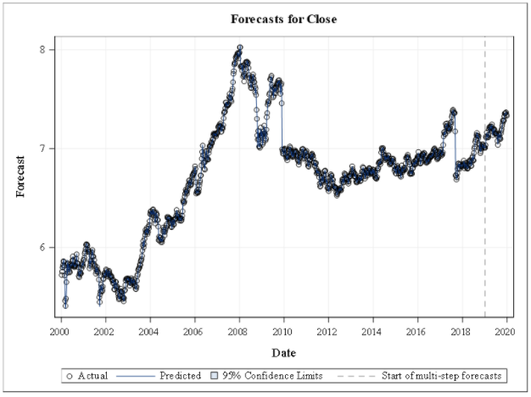
ARIMAX Model
Built model with p=2, d=1, q=1 and independent variables as Prev Close.
Forecast plot shows that the predicted values followed the trend.

Slide 13
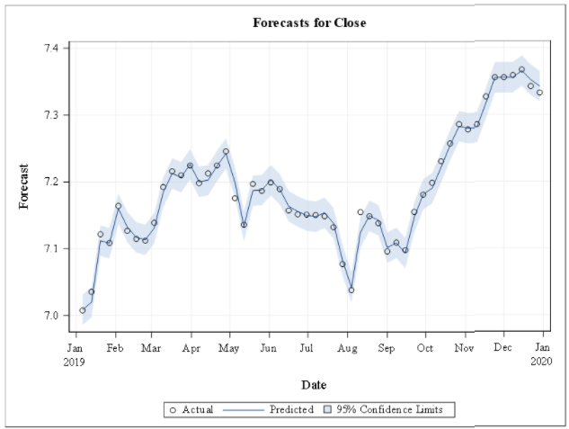
Forecasting Process
Original data spans 2001-2020
Data was first broken into a training and validation.
The models were trained using 2001-2019 and validated with 52 weeks of 2020
Our model is accurate with an MAPE value of 0.11%.

Slide 14
Model Comparison: 2001-2020
 | Double Brown | Holt Model | Damped Model | ARIMAp2 | ARIMA P4 Q2 | ARIMAX P2 | ARIMAX P2 Q1
AIC | -6291.26 | -6545.5 | -6483.12 | -3752.81 | -3771.9 | -6393.82 | -6323.63
SBC | -6286.30 | -6530.65 | -6473.22 | -3567 | -3736.71 | -6373.83 | -6298.88
MAPE | 0.51% | 0.45% | 0.45% | 0.54% | 0.54% | 0.13% | 0.11%
MAE | 0.034 | 0.03 | 0.03 | 0.036 | 0.036 | 0.0087 | 0.0074
ARIMAX Model with AR order 2 and MA 1 is accurate and simple
Notes:
Andy
P-values used to determine model parameters with most data
Model types TBD
Dependent variable is CLOSE
ARIMA2 Autoregressive Factors
Pre-COVID: 1 - 0.35921 B**(1) - 0.00464 B**(2)

Slide 15
The predicted values and the actual values are in the 95% confidence interval and are moving closely in the plot.
The model that we created has done a good job in forecasting the values for 2020.
Takeaway
Notes:
The pre-covid forecasting model is similar to the post-covid forecasting model. Both models did a good job of forecasting the Close price. The pre-covid model should still do a good job of forecasting the Close price in the post-covid data.
ARIMA2
Pre-COVID: 1 - 0.35921 B**(1) - 0.00464 B**(2)
Post-COVID: 1 - 0.25654 B**(1) - 0.05343 B**(2)

Slide 16
This concludes, even when the pandemic hit there was no effect on the performance of stocks of Reliance Industries.
By using this model, we can forecast the performance of stocks for other Industries in the same sector as well.
There are multiple events over the years where Reliance industries have failed acquisitions and there is no significant change in the price of the stock. So, Reliance industries can can make new acquisitions and there will be no significant change in the stock price.
Conclusion & Recommendations

Slide 17

Notes:
We would like to thank Professor _Sudip_ for a great semester and his TA’s_Prakhar_,_Supriya_ for their support . At this point we would like to ask if there are any questions

